Slide 1

Crash Course in Statistics for Neuroscience Center Zurich, R
Zofia Baranczuk
25.08-27.08 2025

Slide 2
Plan
Day 1: Intro, Data Sets, Probability
Day 2: Data Wrangling, Plotting, Hypothesis Testing
Day 3: Simulations, Linear regression
Breaks: 9:50, 10:50, , 12:00 - 13:00, 13:50, 14:50

Slide 3
Introduction to R and R Markdown

Slide 4
Example 1, depression per country
01_Intro.Rmd
depression-rates-by-country-2025.csv
Learning Goals: use R, in Rstudio, compile your .Rmd file to .doc (or .pdf if you have latex), code chunks vs. text chunks, read the data (here: from a link), work with a data frame, visualize the data
R: https://cran.r-project.org/bin/windows/base/
Rstudio: https://posit.co/download/rstudio-desktop/

Slide 5
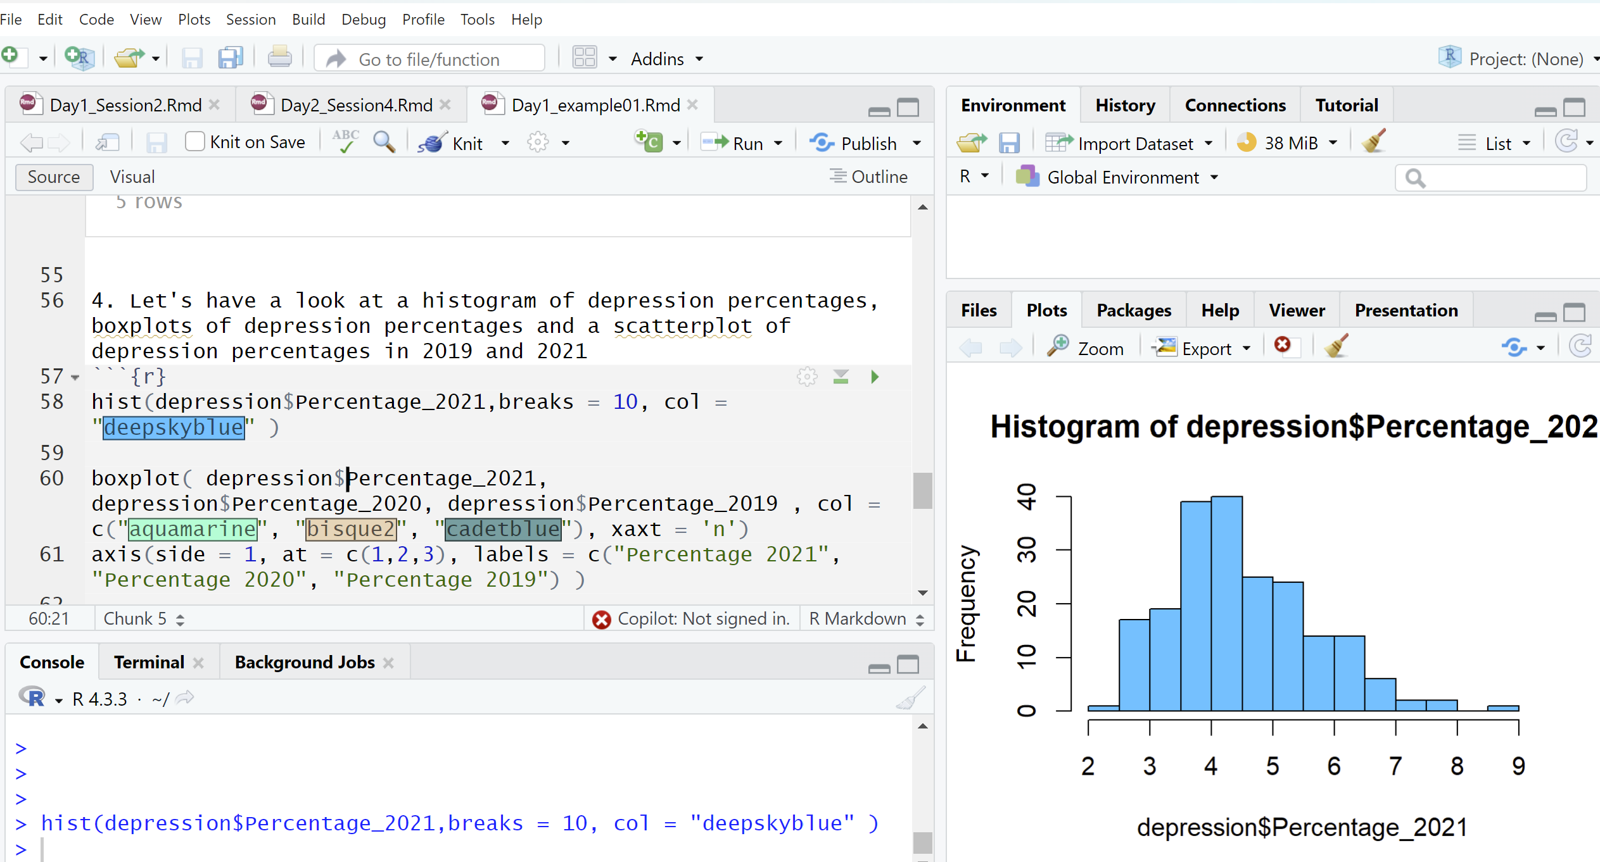
R code in the console vs. R (Markdown) file
Write code in the file, when it is used for the analysis to make sure it is saved, reproducible.
The code in the console will not be saved, useful for some quick checks, calling help pages, installing packages

Slide 6
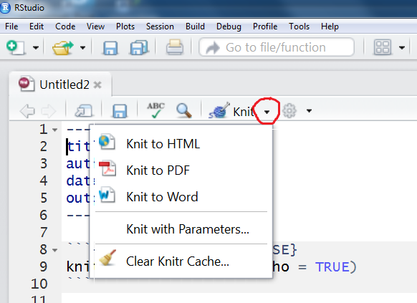
Complining R Markdown

Slide 7
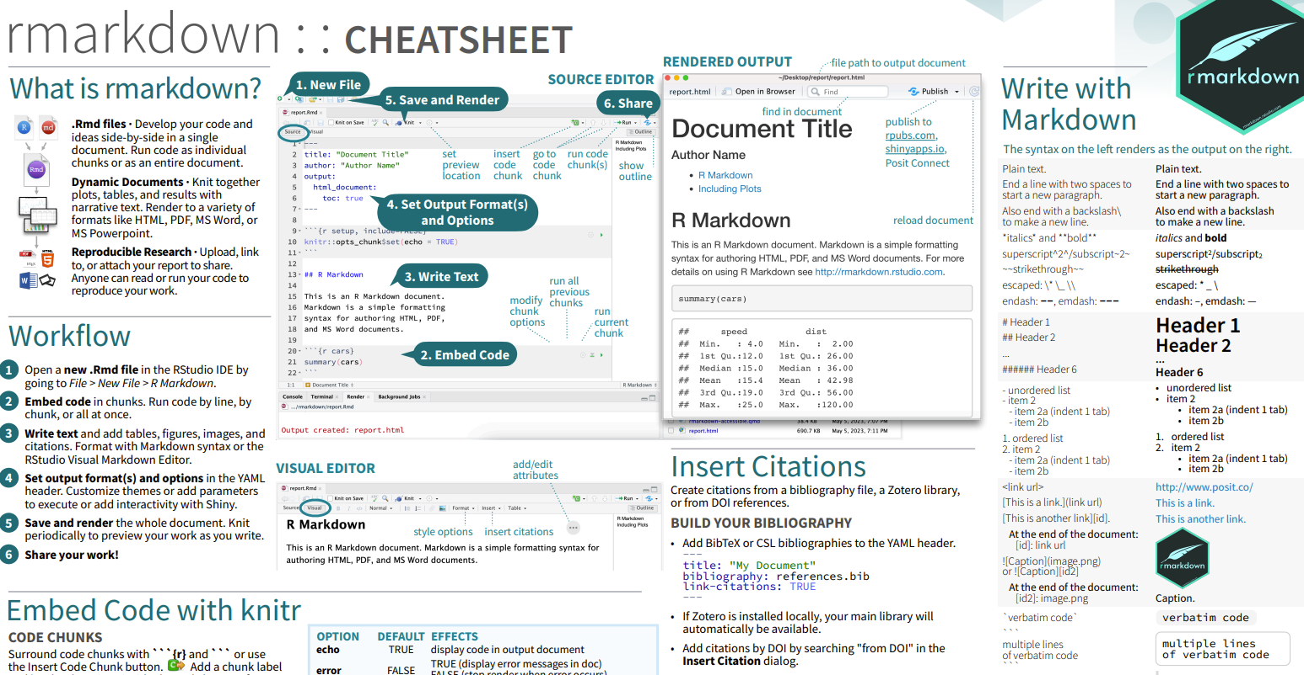
R Markdown cheat sheet
https://rstudio.github.io/cheatsheets/rmarkdown.pdf

Slide 8
Packages
We used a couple of functions:
plot(), histogram(), max() –available directly in R. “Base R”
Package – a unit of shareable code, data, documentation.
To install packages:
install.packages("package-name-in-quotes")

Slide 9
Reading the data
.csv, .txt, .Rdata (for .json, .xlsx you can use corresponding packages)
From a url, from a local file, directly available in R, from a package

Slide 10
Reading data sets
02_DataSets
Learning Goals: read the data from different sources (.txt, .csv, .Rdata, from a package, directly from R). Installing a package and loading a package.

Slide 11
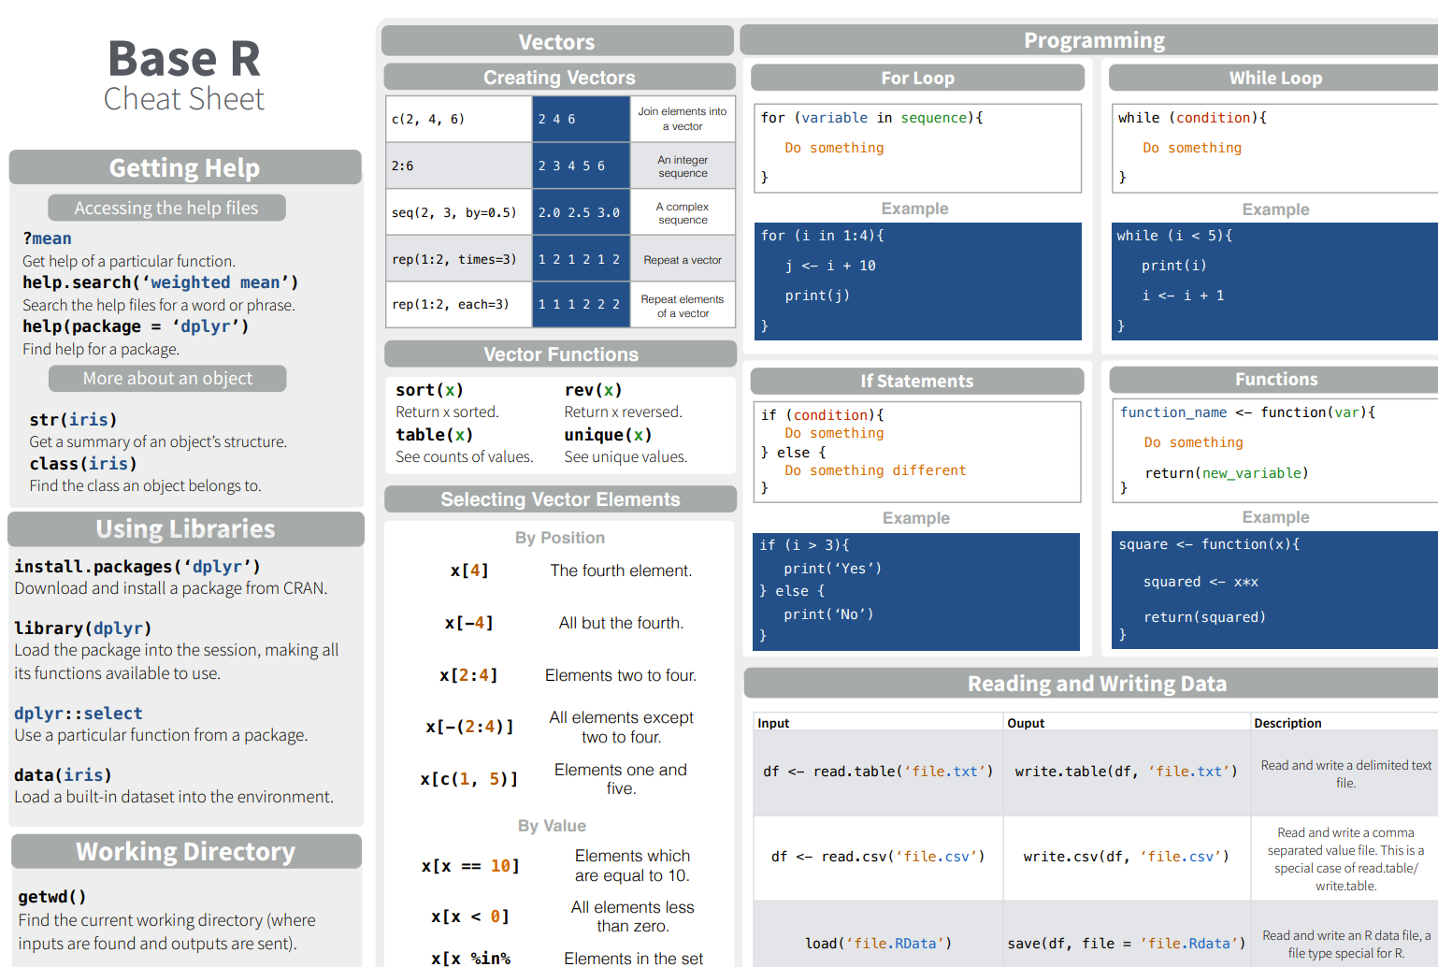
Base R
https://iqss.github.io/dss-workshops/R/Rintro/base-r-cheat-sheet.pdf

Slide 12
Probability distributions
03_ProbabilityDistributions.Rmd
Learning goals:
Working with the density function (d*), probability mass function (d*), cumulative distribution function (p*), quantile function (q*) for the normal (*norm), binomial, Poisson, Exponential and Uniform distributions
Plotting these functions
“?” in R
Sampling from a distribution
Getting information about the distribution using simulations
Getting t-distributed sample using the normal distribution

Slide 13
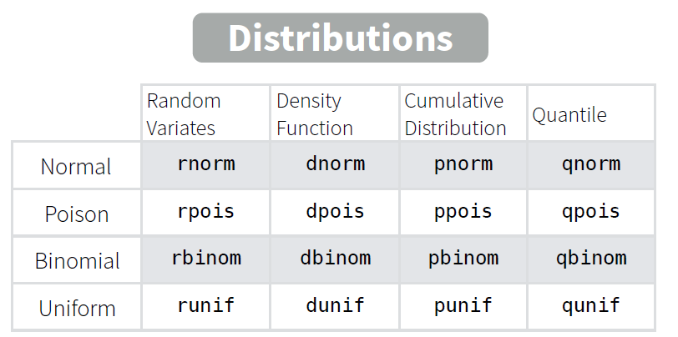
Probability distributions in R

Slide 14
Data Wrangling
04_DataWrangling
Learning goals: pivot tables with dyplr,
group_by() %>% summarize() from the dplyr package
Learn mutate() and select() to work column-wise
Pick observations by their values (filter()).
Reorder the rows (arrange()).
Pick variables by their names (select()).

Slide 15
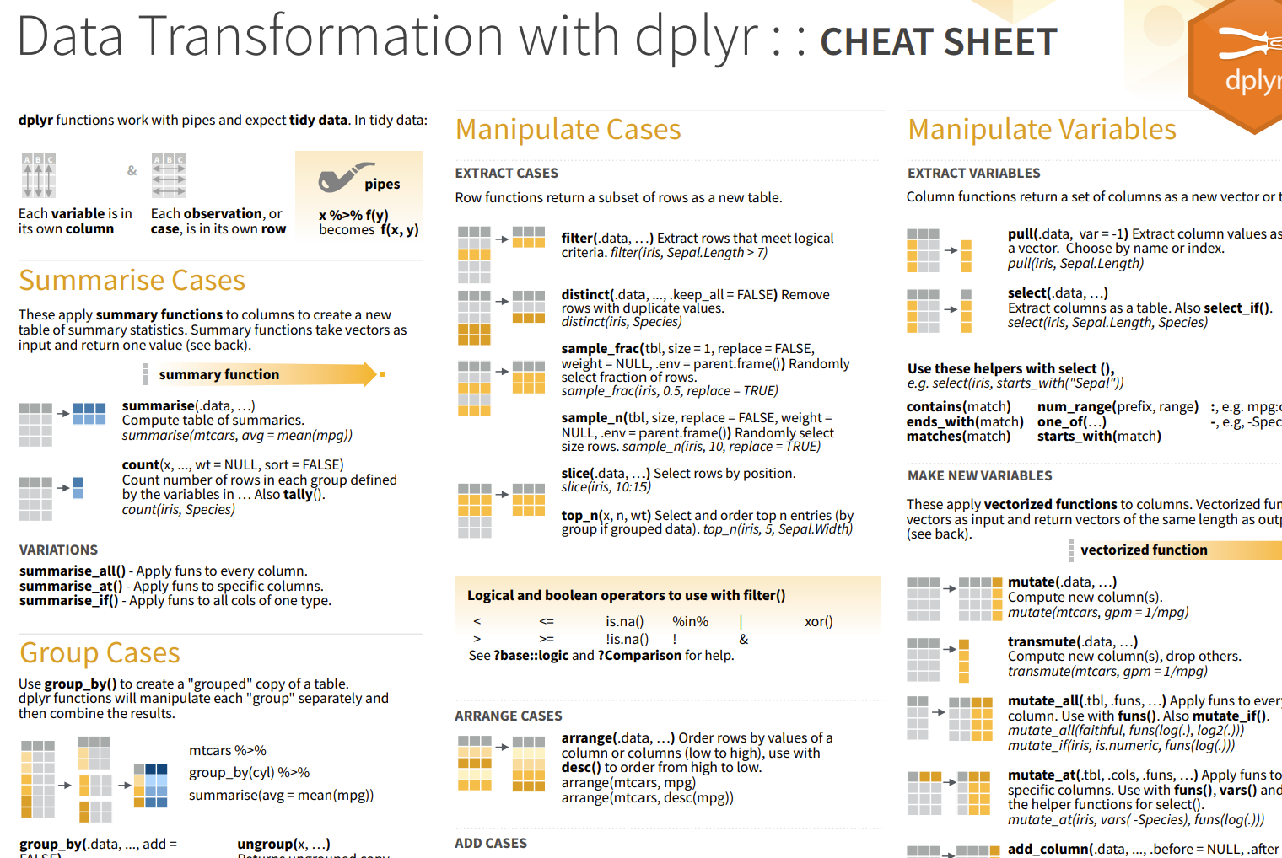
https://nyu-cdsc.github.io/learningr/assets/data-transformation.pdf

Slide 16
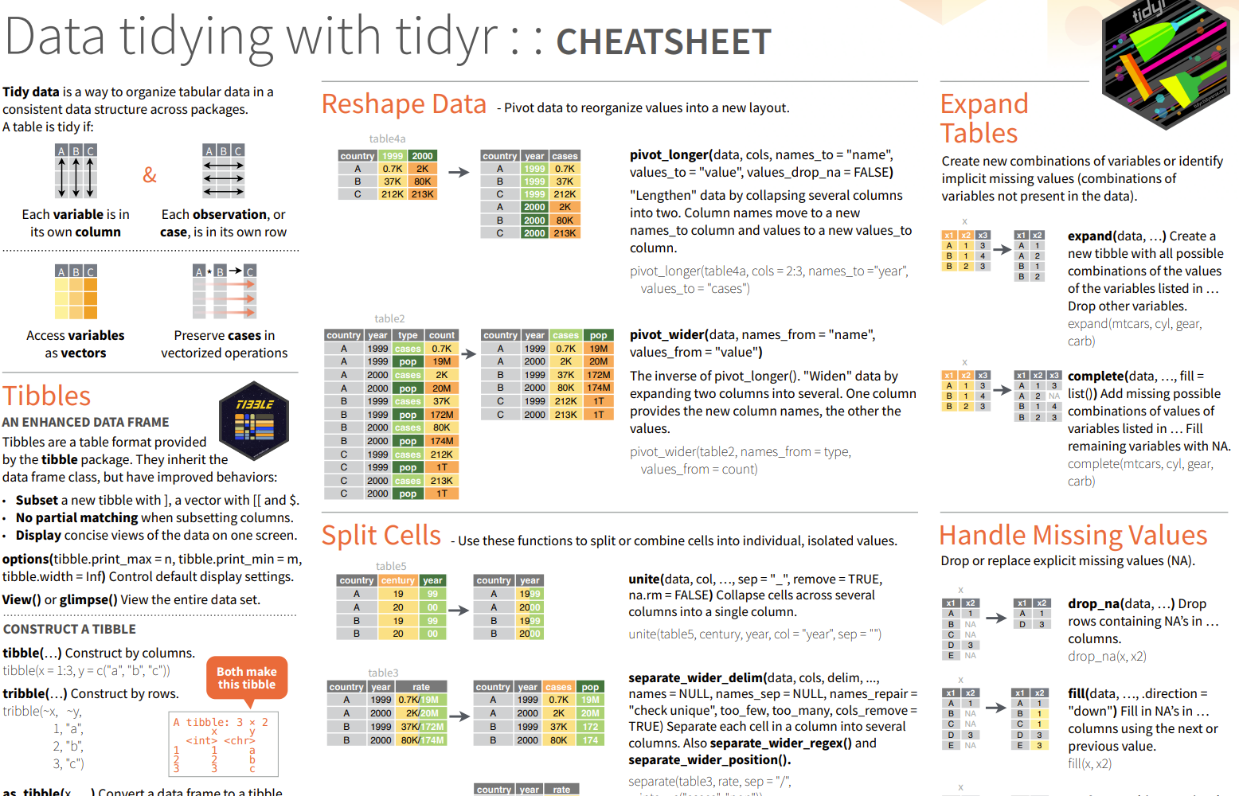
https://rstudio.github.io/cheatsheets/tidyr.pdf

Slide 17
Visualization
05_Visualization
Learning goals: making aesthetic plots in R.

Slide 18
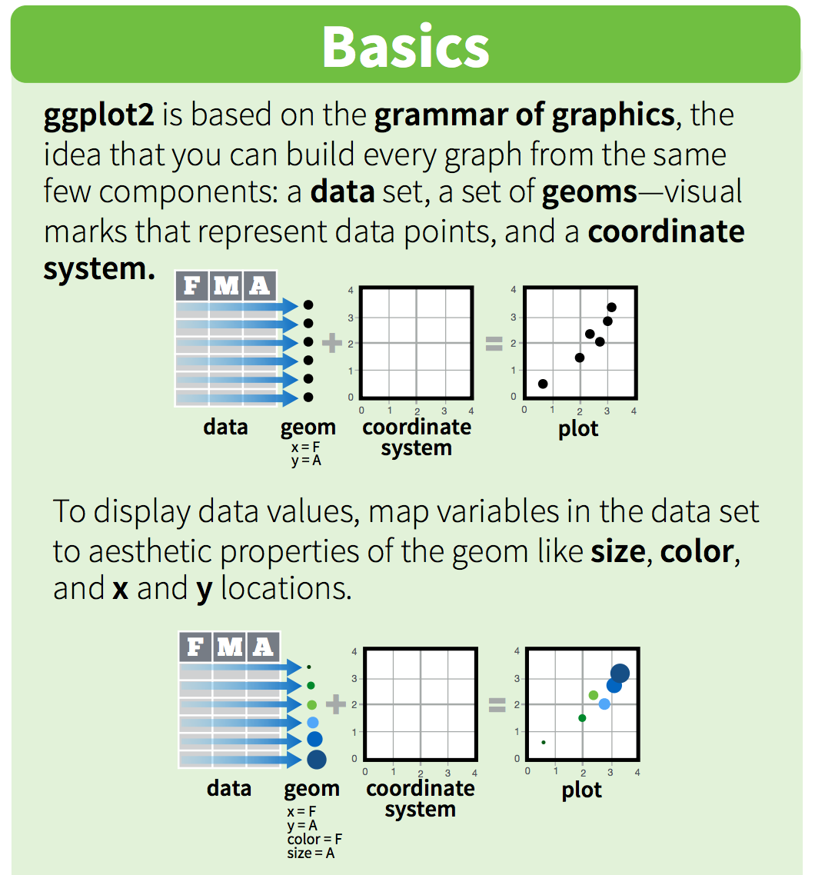
See: https://rstudio.github.io/cheatsheets/data-visualization.pdf

Slide 19
Statistical testing
06_Statistical testing
Learning goals: apply and interpret various tests in R. Understand the importance of assumptions and the influence on the results.

Slide 20
Simulations
07_Simulations.Rmd
Learning goals: Use simulations to build intuition about statistical concepts.

Slide 21
Linear regression
08_LinearRegression
Learning goals:
Apply linear model in R, check the assumptions, interpret the output.
Multicollinearity, influential points, interactions between variables, categorical variables (factors).
Linear regression assumptions not fulfilled - examples
Making predictions in linear model

Slide 22

Thank you ☺
Evaluation:
https://forms.gle/CoBy497Ztn3UsQM5A

